Slide 1

STOCK MARKET FORECASTING USING LSTM AND ARIMA MODEL
Team members:
Anish Acharaya [21075396]
Bhuwan Parsad Joshi [21075406]
Chetan Babu Bhat [21075409]
Pradeept Jarur Shahi [21075421]

Slide 2
Contents
Introduction
Problem Statement
Objective
Literature Review
Methodology
Implementation
Evaluation
Results and conclusion
References

Slide 3
Introduction
Nepal’s stock market is highly unpredictable due to political and external factors.
Stock trend prediction is crucial for investors and decision-makers.
Large data sets make manual analysis challenging.
Predictive models like ARIMA help analyze trends and improve forecasting.

Slide 4
Problem statement
Nepal’s stock market is volatile, making trend prediction difficult.
Investors struggle to determine the right time to buy or sell stocks.
Manual analysis is challenging due to the vast amount of market data.
A reliable predictive model is needed to analyze trends and improve investment decisions.

Slide 5
Objective
To Study and Compare LSTM and ARIMA models for Stocks Forecasting in Nepal’s Context.

Slide 6
Literature Review
Deep learning algorithms are more efficient than traditional predictors for financial forecasting, handling correlations and overfitting issues effectively.
- J.B. Heaton et al
The ARIMA model, evaluated using AIC and MAE, shows minimal accuracy variation with dataset changes, while LSTM is proven effective for time series prediction.
- Mondale et al
LSTM learns stock price patterns effectively, achieving lower MAE and RMSE values, and the sliding window technique improves results.
- Hengijian Jia et al
LSTM outperforms ARIMA by a large margin (84-87%) and shows no significant improvement with increased iterations.
- Sima Siami-Namini
LSTM-based models, using one-week prior data, provide the most accurate predictions for the NIFTY 50 index.
- Mehtab

Slide 7
Methodology
Data Collection: Stock data for Nabil Bank Limited (NABIL) was manually collected from NepseAlpha covering March 20, 2011 – Dec 5, 2024, including date, symbol, open, high, low, close, and volume.
Data Preprocessing: 'Date' and 'Close' columns were selected, MinMaxScaler normalized closing prices, and data was split into 85% training and 15% testing.
LSTM Model Architecture: LSTM was used with a batch size of 32, 200 epochs with an EarlyStopping Callback, and RMSE to evaluate prediction accuracy based on 60-day sequences.
ARIMA Model Architecture: ARIMA was employed with parameters p, d, and q to forecast stock prices based on past data.
Evaluation Metrics: RMSE, MSE, MAPE, and Residual Analysis were used to evaluate model performance.

Slide 8
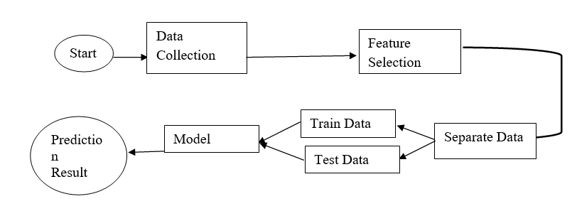
System diagram:

Slide 9
Result
LSTM has lower RMSE (11.68) and higher accuracy (98.75%) compared to ARIMA (RMSE 43.63, accuracy 92.25%).
ARIMA’s residuals fluctuate widely, while LSTM’s remain more stable and closer to zero.
ARIMA predicts a steady decline below 500 but struggles with sudden market changes.
LSTM closely follows historical trends and adapts better to stock price movements.
Overall, LSTM is the superior model for accurate and realistic stock price prediction.
Evaluation Metrics on ARIMA and LSTM Models.
 | ARIMA Model | LSTM Model
Mean Squared Error | 3675.90 | 136.424
Root Mean Squared Error | 60.29 | 11.68
Accuracy of Prediction | 89.23% | 98.88%

Slide 10
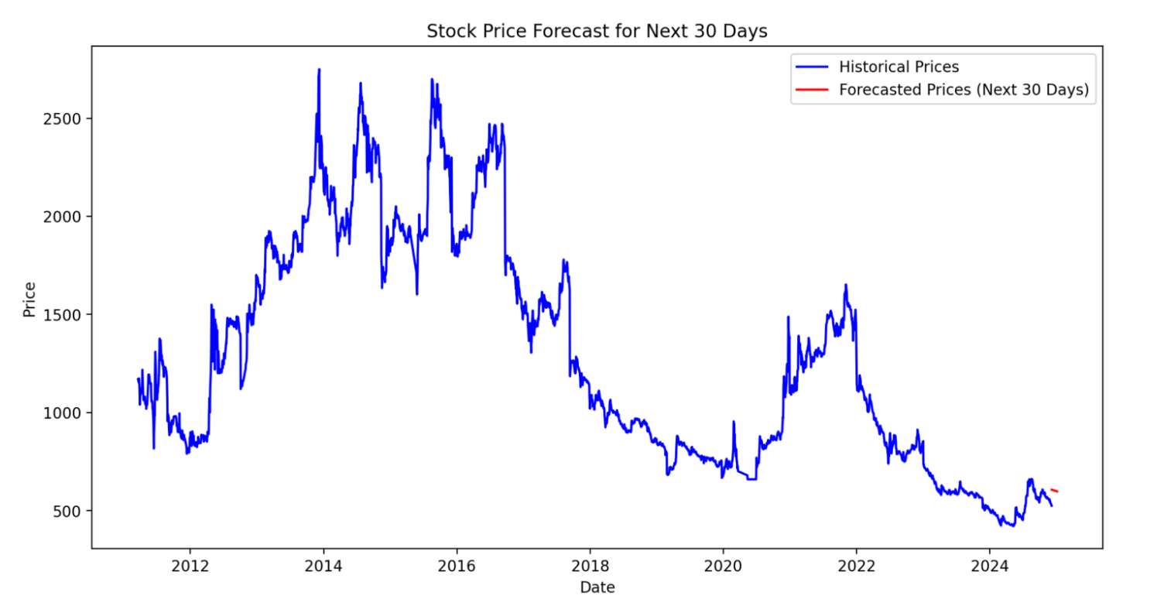
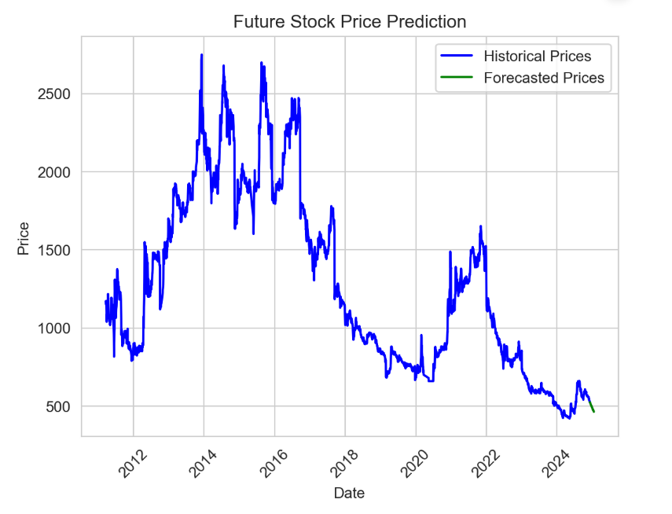
Forecasting
Fig: ARIMA vs LSTM

Slide 11
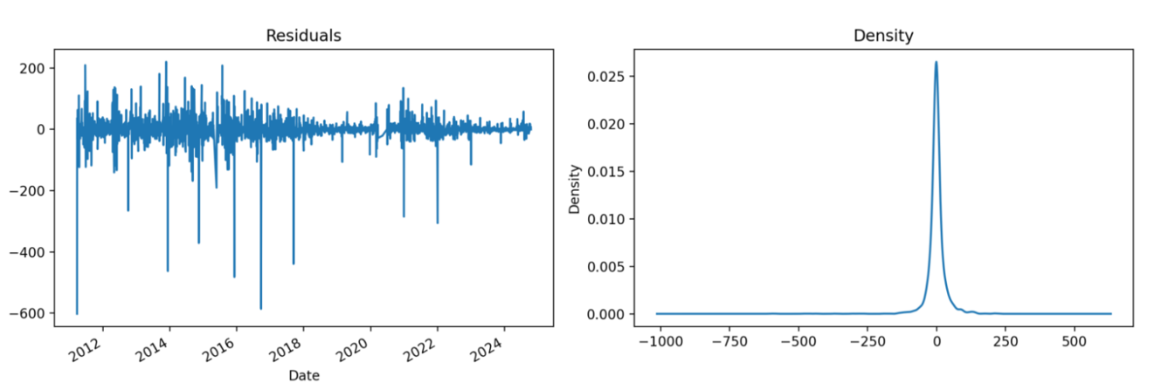
Residual Analysis
ARIMA

Slide 12
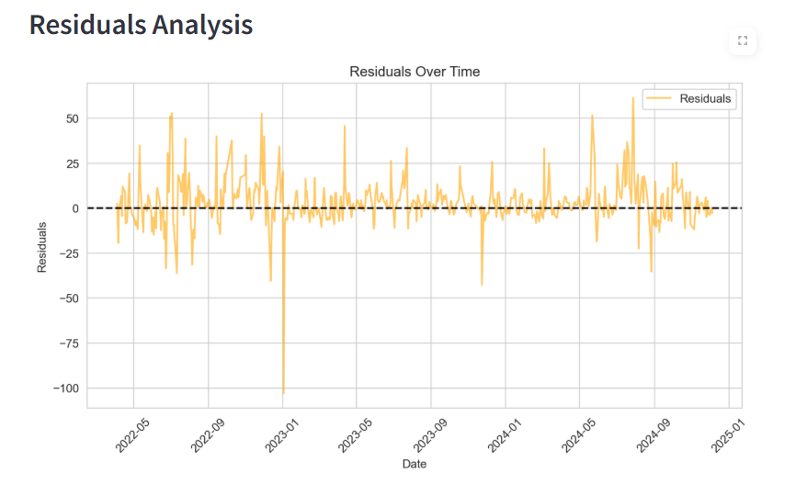
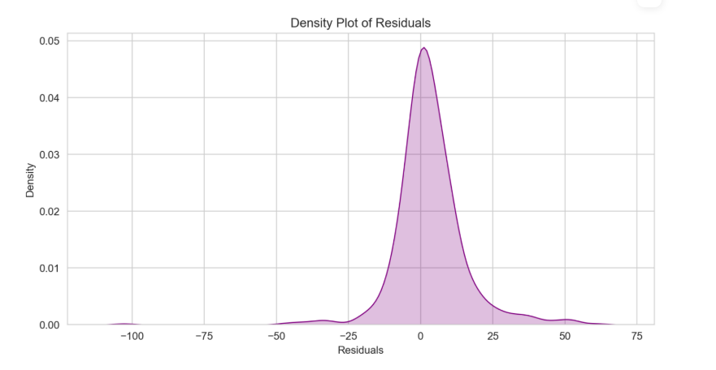
LSTM

Slide 13
Future extensions
Hybrid LSTM + ARIMA model.
Add data like trading volume or market news.
Test on other stocks for broader insights.

Slide 14
References:
[1] | "Deshmukh, Yogita & Saratkar, Deepmala & Tiwari, Yash. (2019). Stock Market Prediction Using Machine Learning. IJARCCE. 8. 31-35. 10.17148/IJARCCE.2019.8107.".
[2] | "Adebiyi, Ayodele & Adewumi, Aderemi & Ayo, Charles. (2014). Stock price prediction using the ARIMA model. Proceedings - UKSim-AMSS 16th International Conference on Computer Modelling and Simulation, UKSim 2014. 10.1109/UKSim.2014.67.".
[3] | "Heaton, J. B., Polson, N. G., and Witte, J. H. (2017) Deep learning for finance: deep portfolios. Appl. Stochastic Models Bus. Ind., 33: 3–12. doi: 10.1002/asmb.2209.".
[4] | Siami Namini, Sima & Siami Namin, Akbar. (2018). “Forecasting Economics and Financial Time Series: ARIMA vs. LSTM.” https://doi.org/10.48550/arXiv.1803.06386.
[5] | Mondal, Prapanna & Shit, Labani & Goswami, Saptarsi. (2014). “Study of Effectiveness of Time Series Modeling (Arima) in Forecasting Stock Prices”. International Journal of Computer Science, Engineering and Applications. 4. 13-29. https://doi.org/10.5121/ijcsea.2014.4202.
[6] | Mehtab, Sidra & Sen, Jaydip & Dutta, Abhishek. (2020). “Stock Price Prediction Using Machine Learning and LSTM-Based Deep Learning Models”. https://doi.org/10.36227/techrxiv.15103602.

Slide 15
THANK YOU
We’re now open to queries

